Slide 1

WATER TREATMENT
PREPARED BY:
Susan Lama
(070BME646)

Slide 2
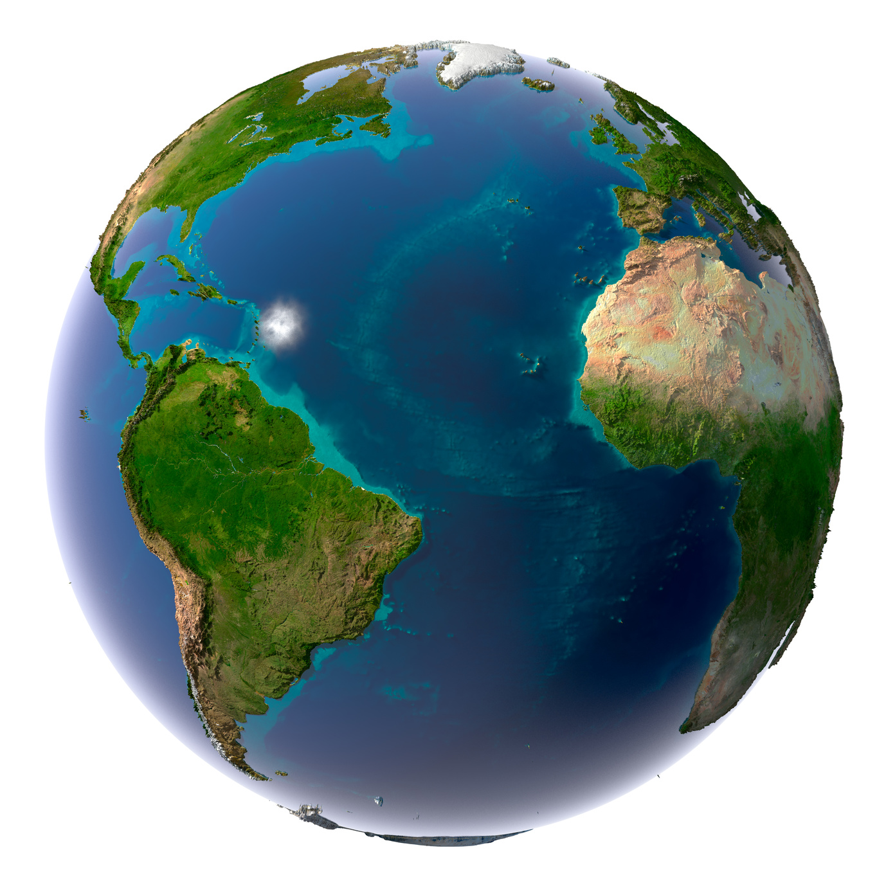
Notes:
About 71 % of the Earth’s surface contains water. Millions of gallons of water are being treated and transported to millions of people every day. Water is a vital part of our nutrition, diet and survival. It is needed for us to live and maintain a healthy lifestyle
http://www.elearning-africa.com/eLA_Newsportal/wp-content/uploads/Fotolia_26790321_M.jpg

Slide 3
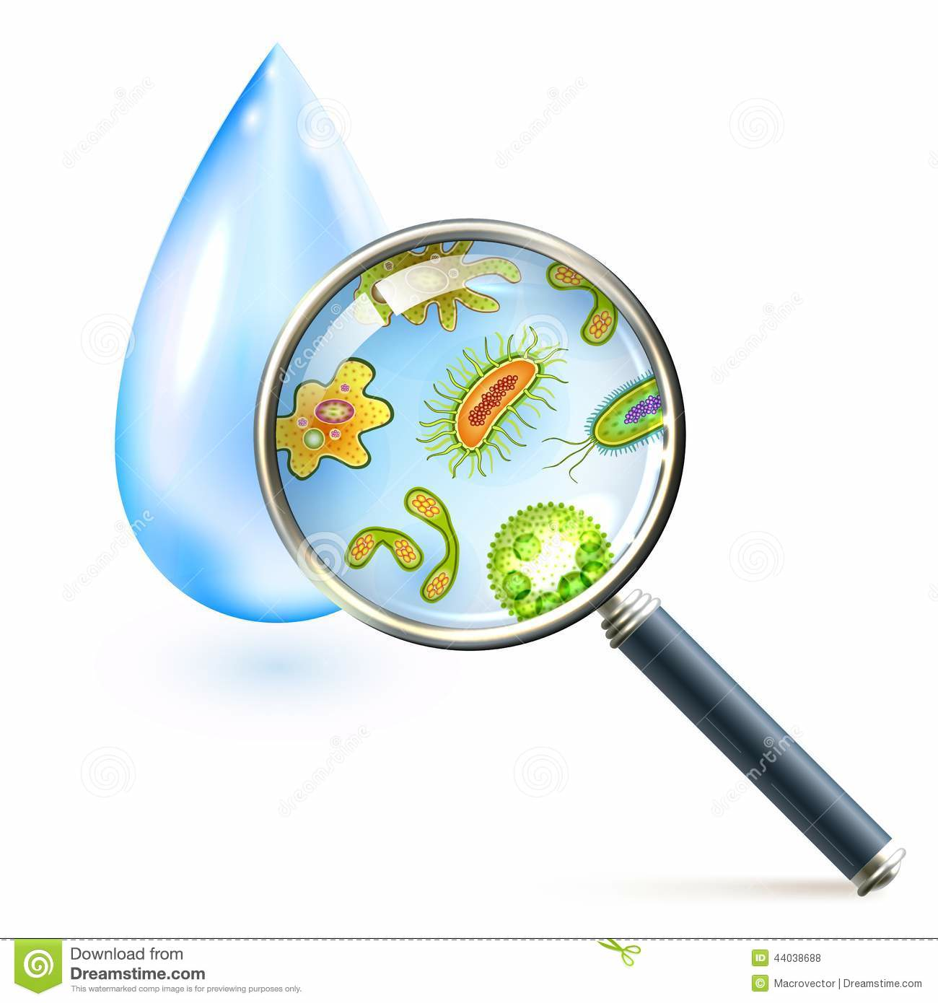
Sediments
Virus
Bacteria
Notes:
Most of the water in the world is filled with viruses, bacteria, microbes, and other harmful particles.
http://thumbs.dreamstime.com/z/magnifier-bacteria-virus-cells-water-drop-vector-illustration-44038688.jpg

Slide 4
Raw Water
Notes:
The water that contains these impurities is known as “Raw Water”.

Slide 5
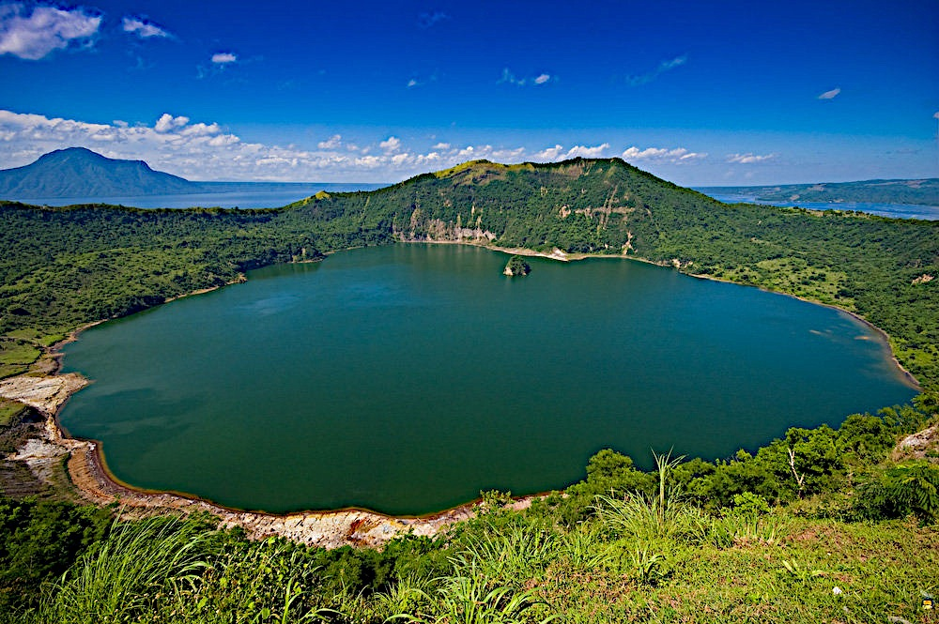
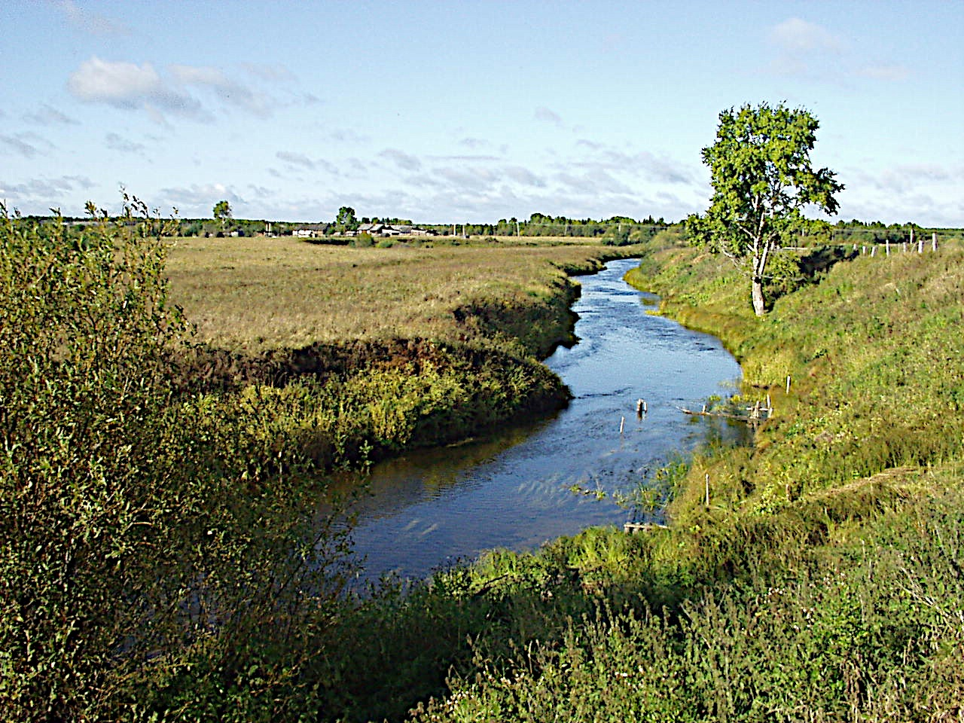
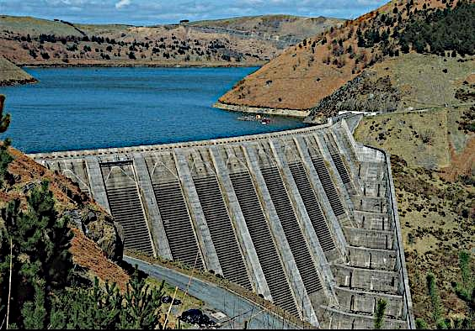
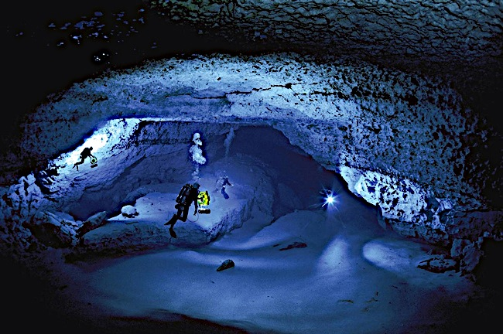
Raw Water
Notes:
Raw water is found in various locations, such as lakes, streams, reservoirs, wells, underground aquifers, etc.
http://www.lovethesepics.com/wp-content/uploads/2012/12/Crater-Lake-at-the-Mouth-of-Taal-Volcano-in-Luzon-Philippines.jpg
http://upload.wikimedia.org/wikipedia/commons/4/48/Arkhangelskaia_oblast_Plesetskiy_Raion.JPG
http://webworld.unesco.org/water/ihp/publications/waterway/webpc/12.jpg
http://floridaspringsinstitute.org/Resources/Pictures/Springs1.jpg

Slide 6
Water Treatment Process
Coagulants
Coagulation
Flocculation
Sedimentation
Raw
Water
Disinfection
Distribution
Home Consumption
Treated Water Storage
Filtration
Notes:
The transformation of raw water to drinking water is called water treatment, and is a very large business around the world. Water treatment is needed to eliminate the risk of waterborne diseases and reduce the levels of harmful disinfectant by-products. Treatment results in improved odor, taste and appearance of the water received from these process plants.
Each specific additive or detailed method varies from plant to plant depending on the type of impurities found in the raw water. However, no matter where the water is obtained, there are 6 general stages that all raw water must go through to become useable, treated water. Water is sent to pumping stations from various bodies of waters to the treatment facilities.

Slide 7
Water Treatment Process
Coagulants
Coagulation
Flocculation
Sedimentation
Raw
Water
Disinfection
Distribution
Home Consumption
Treated Water Storage
Filtration
Notes:
Stage 1- Coagulation-Flocculation
The first step in treating drinking water involves the removal of sediments and particles. In the collected water, chemicals known as coagulants are added. Coagulants, such as aluminum sulfate are added to thicken the water and form flocks of bacteria, mud and other impurities

Slide 8
Coagulation
Suspended particles
Repeal each other
Coagulant
Attract each other
Neutral particles
Notes:
Most of the particles in the raw water have a negative charge, which make them repeal each other. The coagulants, which have a positive charge, react with the negative particles, forming neutral particles. After the coagulants are added, the water is rapidly mixed so the coagulants are dispersed and the particles collide to form bigger clumps, called microflocs.

Slide 9
Water Treatment Process
Coagulants
Coagulation
Flocculation
Sedimentation
Raw
Water
Disinfection
Distribution
Home Consumption
Treated Water Storage
Filtration

Slide 10
Particles collide and link together through weak bonds
And form big clumps called flocs
Notes:
In flocculation the water goes through a gentle mixing so the microflocs formed do not disintegrate and can collide with each other to form even bigger particles, called flocs. The flock is a collection of most of the suspended load and bacteria in the water that caused its turbidity, and once it is formed the water will be clearer.

Slide 11
Water Treatment Process
Coagulants
Coagulation
Flocculation
Sedimentation
Raw
Water
Disinfection
Distribution
Home Consumption
Treated Water Storage
Filtration

Slide 12
Notes:
In the sedimentation chamber the flocs are separated from the water by leaving the water undisturbed to allow the dense particles to settle to the bottom by gravity.

Slide 13
Clean water to filtration
Removal of sediments
Notes:
These suspended solids will then be collected several times daily into a hopper to be removed from the water flow. The sedimentation can also occur by pumping the flocks to the top for physical removal by skimmers. Although after the sedimentation most of the suspended load and biological contaminants in the water are removed, microscopic bacteria and virus, and other fine solids still remain in the water, and will be removed by the filtration and disinfection.

Slide 14
Water Treatment Process
Coagulants
Coagulation
Flocculation
Sedimentation
Raw
Water
Disinfection
Distribution
Home Consumption
Treated Water Storage
Filtration

Slide 15
Filtration
Water from sedimentation
Clean water to disinfection
Notes:
Once most of the major particles are removed, the water is pushed through layers of activated carbon, sand and gravel to filter out any remaining fine particles and microorganisms. The primary filtration process used is adsorption, where the particles are attracted to the filter material, such as activated carbon, and are gathered on its surface. The secondary process is the straining out of the remaining flocs in the water in a filter where the pores between the filter material, such as sand, are smaller than they are, trapping them preventing them from flowing with the water However, this water is still filled with bacteria, viruses, and other organic matter.

Slide 16
Water Treatment Process
Coagulants
Coagulation
Flocculation
Sedimentation
Raw
Water
Disinfection
Distribution
Home Consumption
Treated Water Storage
Filtration

Slide 17
Disinfection
Disinfecting agents
Microorganisms remaining
Notes:
To kill the remaining disease causing microorganisms, the water must be disinfected. Disinfection is normally done in two ways; either with the addition of chlorine or ozone. 1.9 mg of chlorine is added to every 4 cups of water used to kill germs and bugs. Ozone is supercharged oxygen, added to water as bubbles to scrub and disinfect viruses, germs, and fungi. The disinfectant agent remains active in water to prevent the microorganisms from growing in the plumbing during distribution on water.

Slide 18
Water Treatment Process
Coagulants
Coagulation
Flocculation
Sedimentation
Raw
Water
Disinfection
Distribution
Home Consumption
Treated Water Storage
Filtration
Notes:
After disinfection the water will be stored in a basin to be distributed.

Slide 19
Water Treatment Process
Coagulants
Coagulation
Flocculation
Sedimentation
Raw
Water
Disinfection
Distribution
Home Consumption
Treated Water Storage
Filtration

Slide 20

Notes:
.
Conclusion:
Raw water comes from various sources such as lakes and rivers. Raw water if filled with harmful particles, therefore it must be treated before it is consumed. Going through the water treatment, raw water is filtered and disinfected to kill off and clean out all of the harmful particles. The water is then distributed throughout the society for various uses by humans.

